Slide 1

WRITING THE PERFECT COVER LETTER
From the Center for Career and Professional Development
Notes:
There are a variety of opinions on cover letters. Some reviewers feel they are a critical component of the application, some reviewers only read them if the resume has caught their attention, and there are some reviewers who do not read them. Some reviewers prefer attention grabbing opening paragraphs and prefer a standard, straight-forward introduction. It’s important for students to see cover letters as an important part of the application process because you simply don’t know the preferences of the employer. For some, the cover letter can make or break a candidate’s chances.

Slide 2

WRITINGYOUR COVERLETTERWRITING YOUR COV ERLETTERWRITINGYOUR COVERLETTER WRITIN GYOUR COVERLETTERWRI TINGYOUR COVERLET TER WRITINGYOUR COVERLETTER
WRITINGYOURCOVERLETTER
PRESENTATION OVERVIEW
WRITING THE PERFECT COVER LETTER
What is a cover letter?
What is the purpose of cover letters?
Structure
Business formatting
Paragraph by paragraph
Things to keep in mind

Slide 3

WHAT IS A COVER LETTER?
A COMPLEMENT TO YOUR RESUME
Cover letters are a narrative complement to your resume.
A brief one page document that helps expand on the experiences you showcased in your resume.
Highlights your motivations in applying for the position and why you want to work with this specific organization.
Showcases your personality and values.
Notes:
Back when we mailed in paper resumes, the cover letters introduced the candidate and shared the position for which they were applying. Though we can do this in a subject line nowadays or maybe we are uploading our resume into an application system, cover letters are an excellent way to add depth to our application while also demonstrating our written communication skills. They also show a bit of personality and values in the writing style, word selection, and topics a candidate chooses to discuss.

Slide 4

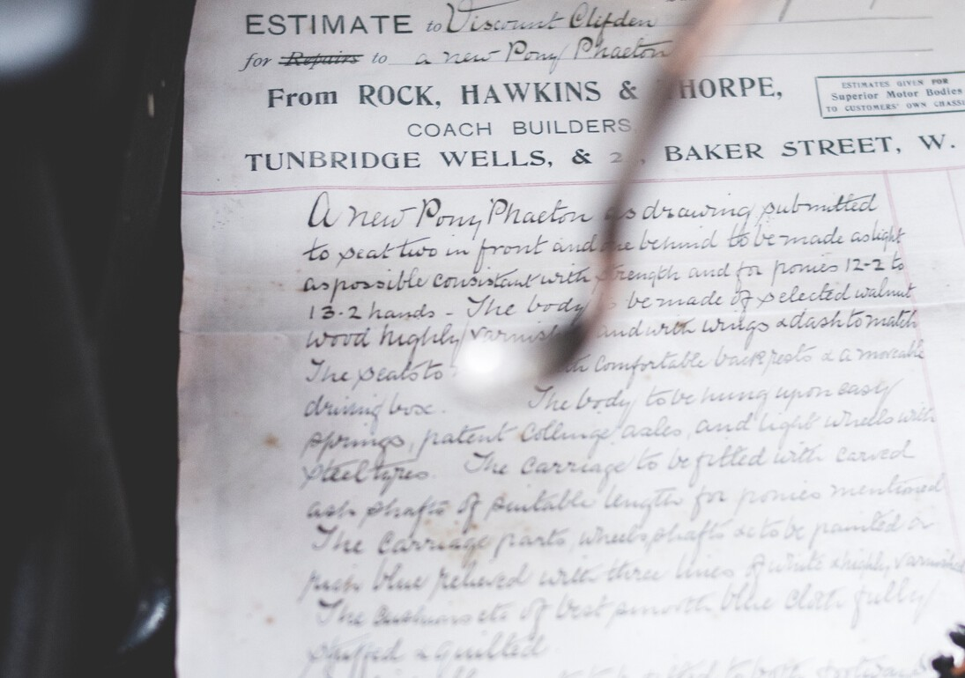
PURPOSE OF A COVER LETTER
Cover letters should highlight your academic, professional, and personal qualifications for the position to which you are applying.
It should not be a restatement of your resume. Instead you should select certain experiences to highlight to the employer. You might weave experiences together, telling how one experience led to another. You might tell a story from one or two experiences that bring depth and detail not covered in your resume.
Notes:
Typically, a reviewer will read the resume first and then come back to the resume and cover letter if they are interested. They can hold more weight in certain fields and positions, especially ones where written communication is important. Cover letters shouldn’t be a list of everything on their resume but instead it is used to TELL THEIR STORY. Students might talk about how they became interested in this field: growing up vising national parks and that sparked their interest in forestry, perhaps they had a family member struggling with addiction and that led to their passion for social work, or maybe they grew up tinkering with computers and have turned it into a career field. Also, maybe they knew they wanted to study philosophy and a guest speaker sparked an interest in medical ethics which led to a summer internship in the field or their engineering curriculum included classes on rapid tooling and prototyping with hands on projects. They might go into detail on a specific experience such as tutoring a third grader in reading and the challenges and successes they faced, or a time they lead a group project for a class as a way to demonstrate their leadership style. These stories bring out their work characteristics, values, and personality, which is what makes them stand out as an individual.

Slide 5

PURPOSE OF A COVER LETTER
A compelling cover letter answers "Why you?" and "Why them?"
Why you: Focus their attention on your most relevant and compelling qualifications. What value will you bring to the organization? (Not what you want or what you can gain.)
Why them: Be sure to include a sentence to a full paragraph on why you want to work with this particular organization. Talk about them. Be sure to match your tone to the organization, i.e. corporate banking tends to be more formal than marketing or nursing. (Don’t confuse formal with professional. All letters should be written with a professional voice and focus. Do not use slang, abbreviations, or a casual tone.)
Cover letters that are just about you are dry and expected. To catch their attention, MAKE A CONNECTION.
Notes:
In addition to telling stories about themselves, students MUST include why they want to work for this particular organization. Sometimes students are applying for dream organizations (just talk with any student applying to the Disney program or NASA!) but sometimes the equation is pretty simple – the student wants to work in finance and this company has a position that aligns with their qualifications. Not every job is the dream and not every person has a desire to feel passionate about their job and workplace, that’s okay. However, they still want to include at least a sentence that demonstrates that this letter was tailored to this letter was targeted for that particular organization and that the students has done a little research to learn about their organization.

Slide 6
STRUCTURE
Introduce yourself – who you are and why you are writing.
Outline why you are interested in the role/industry: your opportunity to demonstrate your knowledge of both the company and the job area.
What can you offer? Highlight key elements of your skills/experience which relate to the post. Remember to give examples/a context, not just a list of the skills you feel you can offer.
Restate your interest, enthusiasm and motivation and perhaps indicate your availability for interview?
Notes:
Typically, a reviewer will read the resume first and then come back to the resume and cover letter if they are interested. They can hold more weight in certain fields and positions, especially ones where written communication is important. Cover letters shouldn’t be a list of everything on their resume but instead it is used to TELL THEIR STORY. Students might talk about how they became interested in this field: growing up vising national parks and that sparked their interest in forestry, perhaps they had a family member struggling with addiction and that led to their passion for social work, or maybe they grew up tinkering with computers and have turned it into a career field. Also, maybe they knew they wanted to study philosophy and a guest speaker sparked an interest in medical ethics which led to a summer internship in the field or their engineering curriculum included classes on rapid tooling and prototyping with hands on projects. They might go into detail on a specific experience such as tutoring a third grader in reading and the challenges and successes they faced, or a time they lead a group project for a class as a way to demonstrate their leadership style. These stories bring out their work characteristics, values, and personality, which is what makes them stand out as an individual.

Slide 7
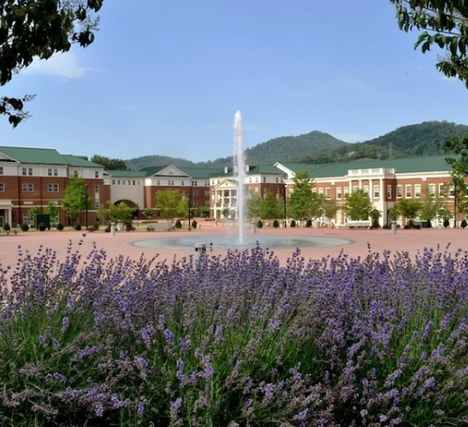
Learning Activity
Notes:
Ask students to think about why they chose Western Carolina University or why they chose their major. Next ask them to think about how they knew they’d be a good fit for WCU or their major?
Have students share their responses popcorn style, in small groups, or in a discussion board.

Slide 8
WHY MAKING A CONNECTION MATTERS
As individuals, when first meeting someone, we tend like people who are similar to us in some way.
A study published in Journal of Social and Personal Relationships showed these three reasons why similarity might increase liking:
Consensual validation: Meeting people who share our attitudes makes us feel more confident in our own attitudes about the world. If you love jazz music, meeting a fellow jazz-lover shows you that loving jazz is OK, and maybe even a virtue.
Cognitive evaluation: This explanation focuses on how we form impressions of other people by generalizing from the information we have. So we learn that a person has something in common with us, and that makes us feel positively about that person, because we feel positively about ourselves. We then assume that the other person, like us, has other positive characteristics.
Certainty of being liked: We assume that someone who has a lot in common with us is more likely to like us. And in turn, we are more likely to like people if we think they like us.
Companies “like” people who can connect with their mission, culture, and employees.
Notes:
Source: https://www.psychologytoday.com/us/blog/close-encounters/201812/why-do-we-people-who-are-similar-us
As people and as potential employers, we tend to have a preference for people who are similar to us, at least upon first meeting. As candidates for a job or internships, cover letters and resumes are often the first meeting. Students need to demonstrate that they have things in common with the organization – skills, values, mission, interests.
Reflect back on where their reasons for choosing WCU or their major reflect these ideas – or ask them to look for examples of this.
Ask students if they were reading application essays potential new Catamounts, would they prefer the essay to be all about the candidate, all about WCU, or a blend?

Slide 9

3 WAYS TO MAKE A CONNECTION
Share a story that shows you connect with their brand or their culture
Tell them how you came to learn that they were special amongst their competitors
Demonstrate why you value them and the work they do
Notes:
Notice how the website is written, read the company’s mission statement and about page, and look for social media accounts or blog. Look for tone, key words, areas of emphasis, etc. Note the organization’s tone and see if they focus on being cutting-edge, innovated, competitive, community focused, philanthropic, nerdy, passionate, etc. Students could share a story to connect to this culture/value.
Students may have a personal experience with the company or this might be from research they’ve conducted and found that the organization has won awards or received recognition from their industry or clients/customers.
Instead of showing a connection to the culture, they might show a shared understanding of the importance of the work the organization does. For example, many people at WCU refer to Chancellor Belcher’s phrase “we are in the business of changing lives” and Chancellor Brown has continued to emphasize that as a regional, public university we are particularly poised to change lives in our communities. If applying to WCU, candidates could speak to the importance of higher education and it’s ability to change lives.
Reflect back on where their reasons for choosing WCU or their major reflect these ideas – or ask them to look for examples of this.

Slide 10
WHAT MAKES UP A COVER
LETTER?

Slide 11
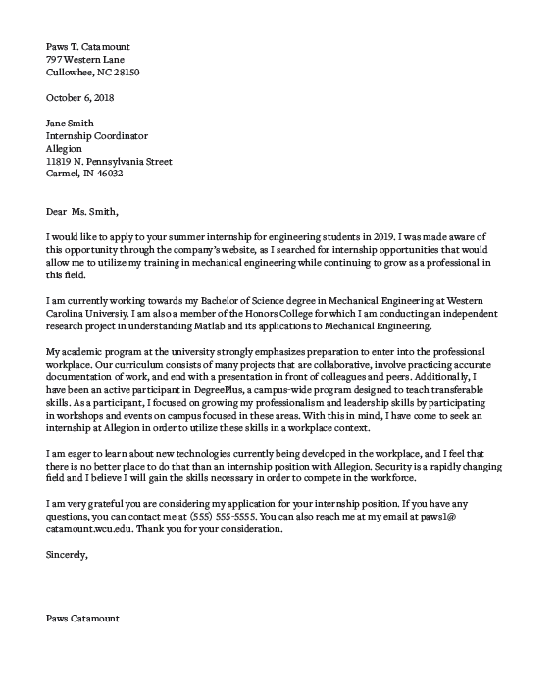
Your Name Your Address Today’s Date Their Name Their Title Their Organization Their Address Greeting, Introduction Paragraph Body Paragraph(s) Closing Paragraph Salutation, Your Name
TRADITIONAL Business Formatting
Notes:
Review of business formatting – many students have not used this previously so it’s good to show and walk through in detail.
NOTE: This is a very traditional format. Styles can differ based on career field or company. When it doubt, we encourage students to be more formal and traditional in their presentation and only use something more creative if they know it is a good fit for the organization. If you are working with students in a particular academic discipline or industry, and know that a different style is preferred, please update this slide or point out the distinctions. For example, less traditional/formal organizations and creative companies often like to see a branded header that matches the resume. Some industries prefer a bullet pointed letter that makes a quick connection between skills and experiences sought and the candidates.

Slide 12
HEADER AND GREETING
PAWS T. CATAMOUNT
797 Western Lane
Cullowhee, NC 28723
OCTOBER 6TH, 2020
JANE SMITH
Internship Coordinator
Allegion Corporation
11819 N. Pennsylvania Street
Carmel, IN 46032
Dear Ms. Smith,
Notes:
Again, students can choose to use this style header for their contact information OR they could use the same header as their resume.
Students are encouraged to find a name to address the letter to if at all possible. They can look at the company staff paged, use LinkedIn, google, etc. Doing this research is a great way to demonstrate their willingness to do a little extra when needed. If they can’t find a name, they can leave it blank and simply use the name of the organization and the mailing address (more on this in the video on slide 13).

Slide 13
Paragraph by Paragraph
OPENING PARAGRAPH
State the position to which you're applying, where you found it/heard about it, name drop if you have a direct connection, and close with a ‘hook’.
ACADEMIC INTRODUCTION
(Used if you are applying for something related to your major)
State the college you are attending, your degree, relevant classes you’ve completed, and other relevant academic information.
BODY PARAGRAPH
Connect your skills, characteristics, experiences, and qualifications to the position and company as a whole.
Highlights what interests you in working with this particular organization.
CONCLUSION AND FORMAL CLOSING
Reaffirm your qualifications and interest in the position and company. Be sure to include your contact information. Could offer to follow up with the employer. End the letter formally.
Notes:
Opening – always state the name of the position, organization, and where they found the job/internship/fellowship. If they have a connection, they should name it in this paragraph (my former supervisor, Keiara Osborne, who now works with this organization or one of your accountants, Tucker McFarland or my professor, Dr. Lily Rodriguez, sent me this opening…and encouraged me to apply). The hook is a brief sentence or two about their interest in the organization and a little about their background to catch the employers attention.
Academic introduction – Not every opportunity students apply to are directly connected to their major. This information is only necessary if students want to highlight this information in connection to the position.
Conclusion – Students can offer to follow up with the employer by stating something like, “I will follow up in one week to ensure you’ve received my materials.” or (more assertive) “I will follow up in one week to inquire about scheduling an interview.” This is optional and should NOT be used if the posting says “no phone calls/emails.” If a student includes this in this letter, they must be sure to follow up on the noted date.

Slide 14
Signature
Salutation,
Your Name Typed
Notes:
Students should include 2-4 blank lines between their salutation and their name types. Including a digital signature (either creating a signature and pasting it in the blank space or printing the letter, signing, and scanning it is optional.
Common salutations include: Sincerely, Thank you, and Best Regards

Slide 15
THINGS TO REMEMER
TOPICS
Why you?
Why them?
Highlight your experiences to showcase you as the best candidate and emphasize your interest in their organization.
STYLE
Should be narrative in style. Match tone of organization and always be professional.
FONT
Use same font as resume for consistency across your documents
LENGTH
No longer than 1 page and around 3-5 paragraphs.
CUSTOMIZE
Tailor and customize your cover letter to each position.
Notes:
Customizing usually means having one solid cover letter that they edit a few sentences to target it to a particular organization, occasionally customizing means writing a fresh one from scratch.

Slide 16
Conclusion
WHY IT MATTERS
A narrative complement to your resume and enhance your qualifications to employers.
HAVE A GOAL IN MIND
Make sure to address the two main questions of "Why me?" and "Why them?"
KEY ELEMENTS
Adds depth to your resume and always ties back to the position for which you are applying.
BE SPECIFIC
Highlight specific examples of relevant academic, professional, or personal experiences.
Notes:
Note on how to send cover letters: save the document as First initial, Last name, and Cover Letter (JSmith Cover Letter) and save as a pdf. They can upload it in an applicant system or as an attachment to an email. In the body of the email, they can say the position they are applying to and a short hook sentence then, “Please find my cover letter and resume attached.” We recommend that students always submit a cover letter, even if not formally requested.

